Slide 1
Digital Logic Design
Chapter 3
Simplification of Boolean Functions

Slide 2
The Map Method
The map method provides a simple straightforward procedure for minimizing Boolean functions.
This method may be regarded either as a pictorial form of a truth table or as an extension of the Venn diagram.
The map method, first proposed by Veitch and modified by Karnaugh, is also known as the “Veitch diagram” or the “Karnaugh map”.

Slide 3
Two- and Three-Variable Maps
There are four minterms for two variables; hence the map consists of four squares, one for each minterm.
A 1 is placed in the square of the minterm which is contained in the function. Otherwise 0 is placed.
y x | 0 | 1
0 | m₀ | m₁
1 | m₂ | m₃
y x | 0 | 1
0 | x’y’ | x’y
1 | xy’ | xy

Slide 4
Two- and Three-Variable Maps
For example: f = x + y
= x’y + xy’ + xy
= m₁ + m₂ + m₃
y x | 0 | 1
0 | 0 | 1
1 | 1 | 1

Slide 5
Two- and Three-Variable Maps
There are eight minterms for three binary variables. Therefore, a map consists of eight squares.
The minterms are not arranged in a binary sequence, but in a sequence similar to the Gray code.
yz x | 00 | 01 | 11 | 10
0 | m₀ | m₁ | m₃ | m₂
1 | m₄ | m₅ | m₇ | m₆

Slide 6
Two- and Three-Variable Maps
Simplify the Boolean function:
F(x, y, z) = x’yz + x’yz’ + xy’z’ + xy’z
Therefore, F(x, y, z) = x’y + xy’
yz x | 00 | 01 | 11 | 10
0 | 0 | 0 | 1 | 1
1 | 1 | 1 | 0 | 0

Slide 7
Two- and Three-Variable Maps
Simplify the Boolean function: F(x, y, z) = ∑(3, 4, 6, 7)
Therefore, F(x, y, z) = yz + xz’
yz x | 00 | 01 | 11 | 10
0 | 0 | 0 | 1 | 0
1 | 1 | 0 | 1 | 1

Slide 8
Two- and Three-Variable Maps
Simplify the Boolean function: F(x, y, z) = ∑(0, 2, 4, 5, 6)
Therefore, F(x, y, z) = z’ + xy’
yz x | 00 | 01 | 11 | 10
0 | 1 | 0 | 0 | 1
1 | 1 | 1 | 0 | 1

Slide 9
Two- and Three-Variable Maps
Simplify the Boolean function:
F(A, B, C) = A’C + A’B + AB’C + BC
= A’C(B+B’) + A’B(C+C’) + AB’C + BC(A+A’)
= A’BC + A’B’C + A’BC’ + AB’C + ABC
= ∑(1, 2, 3, 5, 7)
Therefore, F(A, B, C) = A’B + C
BC A | 00 | 01 | 11 | 10
0 | 0 | 1 | 1 | 1
1 | 0 | 1 | 1 | 0

Slide 10
Four-Variable Map
The map minimization of four-variable Boolean functions is similar to the method used to minimize three-variable functions.
The map is considered to lie on a surface with the top and bottom edges, as well as the right and left edges, touching each other to form adjacent squares.
yz wx | 00 | 01 | 11 | 10
00 | m₀ | m₁ | m₃ | m₂
01 | m₄ | m₅ | m₇ | m₆
11 | m₁₂ | m₁₃ | m₁₅ | m₁₄
10 | m₈ | m₉ | m₁₁ | m₁₀

Slide 11
Four-Variable Map
Simplify the Boolean function:
F(w, x, y, z) = ∑(0, 1, 2, 4, 5, 6, 8, 9, 12, 13, 14)
Therefore, F(w, x, y, z) = y’ + w’z’ + xz’
yz wx | 00 | 01 | 11 | 10
00 | 1 | 1 |  | 1
01 | 1 | 1 |  | 1
11 | 1 | 1 |  | 1
10 | 1 | 1

Slide 12
Five-Variable Map
For five-variable maps, we need 32 squares.
The rows and columns are numbered in a reflected-code sequence.
CDE
110 | 111 | 101 | 100
m₆ | m₇ | m₅ | m₄
m₁₄ | m₁₅ | m₁₃ | m₁₂
m₃₀ | m₃₁ | m₂₉ | m₂₈
m₂₂ | m₂₃ | m₂₁ | m₂₀
 | 000 | 001 | 011 | 010
00 | m₀ | m₁ | m₃ | m₂
01 | m₈ | m₉ | m₁₁ | m₁₀
11 | m₂₄ | m₂₅ | m₂₇ | m₂₆
10 | m₁₆ | m₁₇ | m₁₉ | m₁₈
AB

Slide 13
Five-Variable Map
Simplify the Boolean function F(A, B, C, D, E) = Ʃ(0, 2, 4, 6, 9, 11, 13, 15, 17, 21, 25, 29, 31)
F(A, B, C, D, E) = BE + AD’E + A’B’E’
CDE
110 | 111 | 101 | 100
1 |  |  | 1
 | 1 | 1
 | 1 | 1
 |  | 1
 | 000 | 001 | 011 | 010
00 | 1 |  |  | 1
01 |  | 1 | 1
11 |  | 1 | 1
10 |  | 1
AB

Slide 14
Product of Sums Simplification
For this case we combine the squares which are marked as 0’s.
For example: F(A, B, C, D) = Π(3, 4, 6, 7, 11, 12, 13, 14, 15)
Therefore F(A, B, C, D) = (A’+B’)(C’+D’)(B’+D)
CD AB | 00 | 01 | 11 | 10
00 | 1 | 1 | 0 | 1
01 | 0 | 1 | 0 | 0
11 | 0 | 0 | 0 | 0
10 | 1 | 1 | 0 | 1

Slide 15
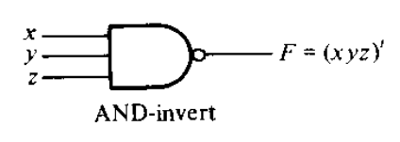
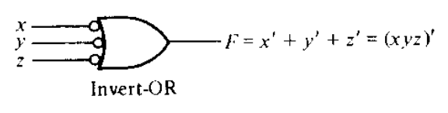
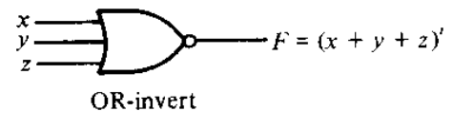
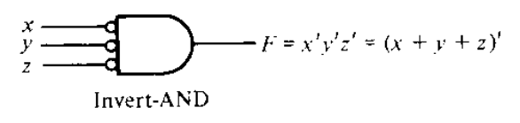
NAND and NOR Implementation
NAND and NOR gates are easier to fabricate with components.
Because of the prominence of NAND and NOR gates in the design of digital circuits, rules and procedures have been developed for the conversion from Boolean functions given in terms of AND, OR and NOT into equivalent NAND and NOR logic diagrams.

Slide 16
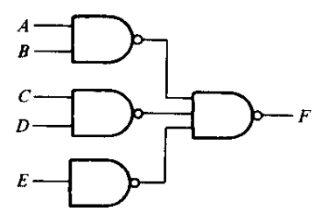
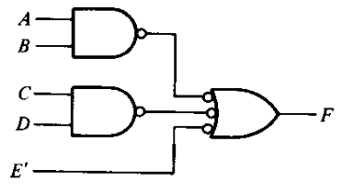
NAND Implementation
Implement the function F = AB + CD + E using NAND gates.
The function F can be written as F = [(AB)’.(CD)’.E’]’

Slide 17
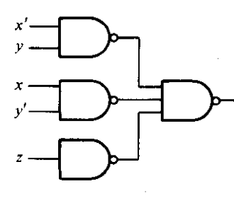
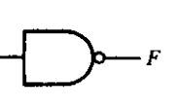
NAND Implementation
Implement the following function with NAND gates.
F = ∑(0, 6)
F’ = x’y + xy’ + z
F’ = ((x’y)’.(xy’)’.(z)’)’
F = (((x’y)’.(xy’)’.(z)’)’)’
yz x | 00 | 01 | 11 | 10
0 | 1 | 0 | 0 | 0
1 | 0 | 0 | 0 | 1

Slide 18
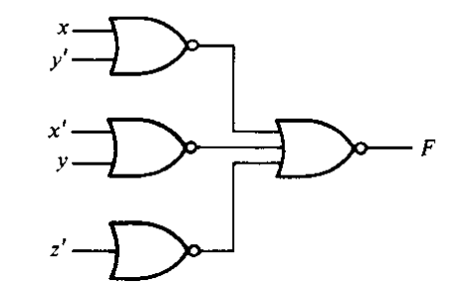
NOR Implementation
Implement the following function with NOR gates.
F = ∑(0, 6)
F’ = x’y + xy’ + z
F = (x + y’)(x’ + y)z’
F’ = (x + y’)’ + (x’ + y)’ + z
F = ((x + y’)’ + (x’ + y)’ + z)’
yz x | 00 | 01 | 11 | 10
0 | 1 | 0 | 0 | 0
1 | 0 | 0 | 0 | 1

Slide 19
Don’t Care Conditions
In practice, there are some applications where the function is not specified for certain combinations of the variables.
Functions that have unspecified outputs for some input combinations are called incompletely specified functions.
In most applications, we simply don’t care what value is assumed by the function for the unspecified minterms.
These don’t care conditions can be used on a map to provide further simplification of the Boolean expression.

Slide 20
Don’t Care Conditions
Simplify the function F = ∑(1, 3, 7, 11, 15) has the don’t care conditions d = ∑(0, 2, 5)
F = yz + w’x’ F = yz + w’z
yz wz | 00 | 01 | 11 | 10
00 | X | 1 | 1 | X
01 | 0 | X | 1 | 0
11 | 0 | 0 | 1 | 0
10 | 0 | 0 | 1 | 0
yz wz | 00 | 01 | 11 | 10
00 | X | 1 | 1 | X
01 | 0 | X | 1 | 0
11 | 0 | 0 | 1 | 0
10 | 0 | 0 | 1 | 0

Slide 21
Determination of Prime Implicants
The process compares each minterm with every other minterm.
If two minterms differ in only one variable, that variable is removed and a term with one less literal is found.
This process is repeated for every minterm until the exhaustive search is completed.

Slide 22
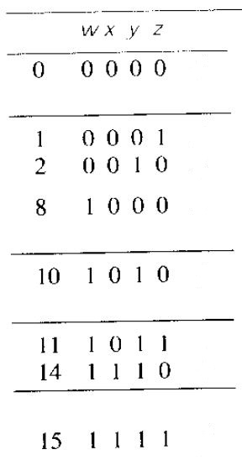
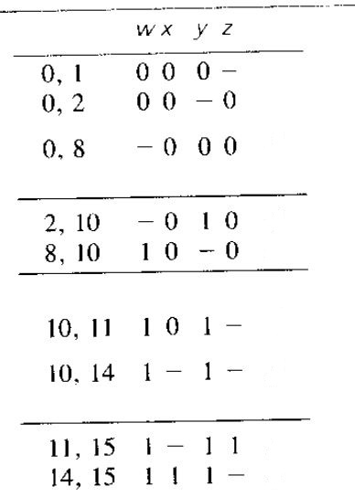
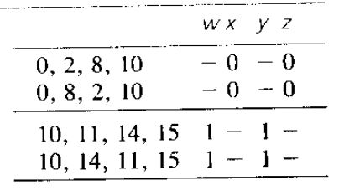
Determination of Prime Implicants
Simplify the function F = ∑(0, 1, 2, 8, 10, 11, 14, 15) by using the tabulation method.
F = w’x’y’ + x’z’ + wy

